Slide 1
Tableau
Jerin Joseph

Slide 2
What is tableau
Tableau is a visual analytics platform transforming the way we use data to solve problems—empowering people and organizations to make the most of their data.

Slide 3
Why tableau
It helps In simplifying raw data in a very easily understandable format.
Business driven solutions
Converting raw data into meaningful insights
Visual Analytics

Slide 4
Process flow of bi project
Business understanding
Data understanding
Data preparation
Modelling
Evaluation
Deployment

Slide 5
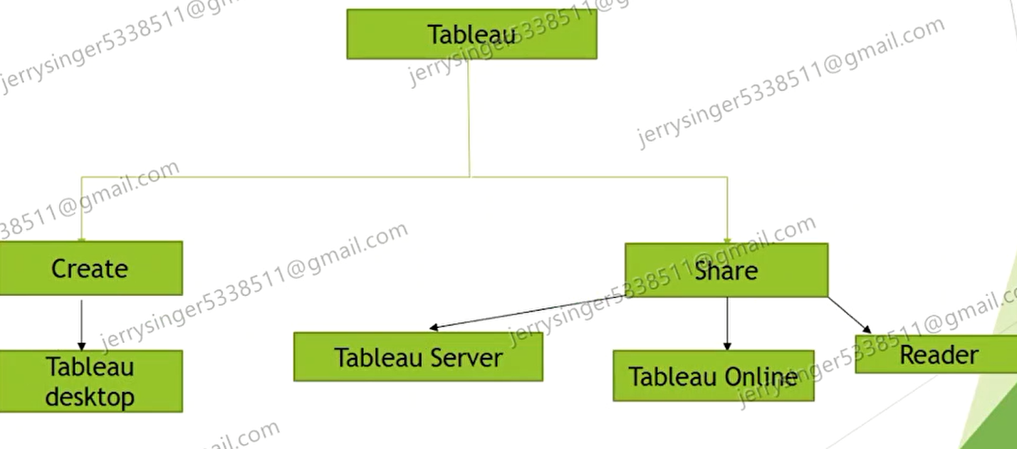
Explain Tableau architecture

